Slide 1

IT Essentials (CompTIA A+) Ch. 15
Maintaining and Optimizing
Operating Systems

Slide 2
Overview
In this chapter, you will learn how to:
Perform operating system maintenance tasks
Optimize operating systems
Prepare for problems
Notes:
2

Slide 3
Introduction
Maintenance – jobs done from time to time to keep the OS running well
Optimization – changes made to a system to make it better

Slide 4
Maintaining Operating Systems
Examples of maintenance tasks include:
Installing the latest system patches released by Microsoft
In a Windows system, keeping the hard drive and Registry organized and uncluttered

Slide 5
Windows Patch Management
All new releases of Windows bring malware attacks, code errors, hardware issues, and issues with new features.
All of these compel Microsoft to provide updates, also known as patches.
Patch management is the process of keeping software updated and safe.
Windows Update is the primary distribution tool for handling patch management.
Control Panel applet

Slide 6
Windows Patch Management
Windows Update separates the different fixes into distinct types: updates and service packs.
Updates are individual fixes that come out fairly often.
A service pack is a large bundle of updates along with anything else Microsoft chooses to add.
Windows 8 later ditched service packs
Big updates get a revision number.

Slide 7
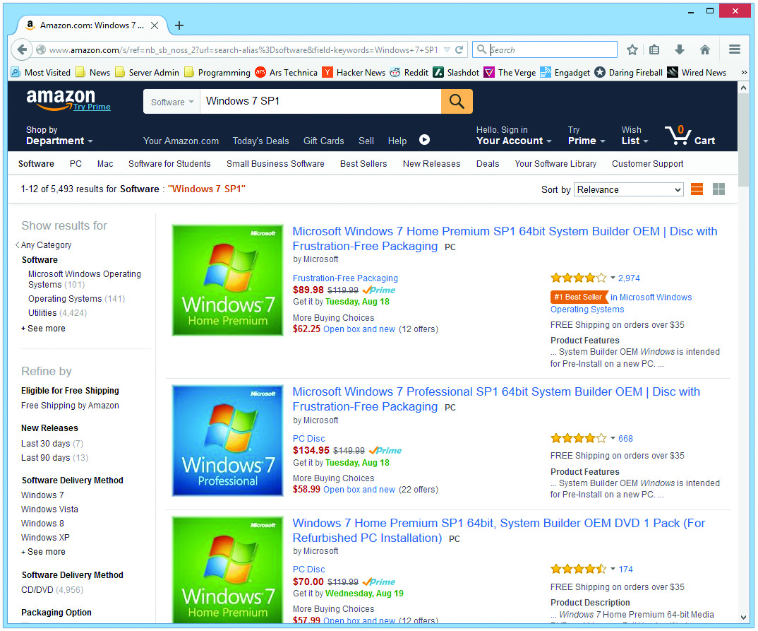
Windows Patch Management
Figure 15.1 Windows 7 with Service Pack 1

Slide 8
Windows Patch Management
Three common types of updates
Important
Address critical security or stability issues and are the most critical
Recommended
Added feature or enhancement that is not critical
Optional
Include device drivers, language packs, and other nonessential updates
Notes:
Windows 8/8.1 offers two interfaces for Windows Update: one for Control Panel and one in the PC settings app. In Windows 10, the Control Panel Windows Update applet is gone and the only Windows Update interface is in the Settings app under Update and Security.
All Windows 10 updates download and install automatically by default; you cannot selectively choose individual updates to download.

Slide 9
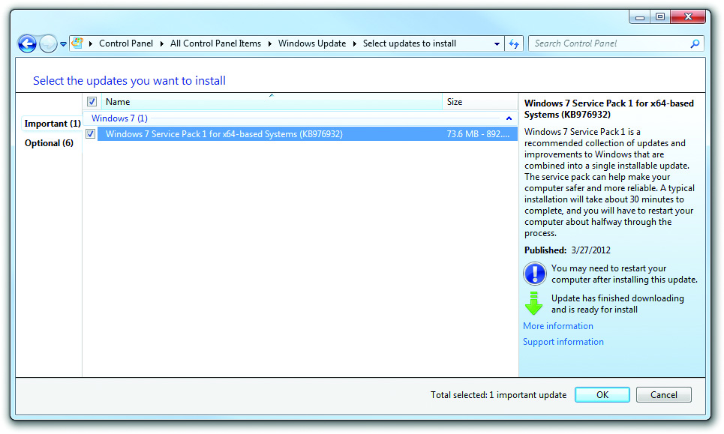
Windows Patch Management
Figure 15.2 Windows Update in Windows 7

Slide 10
Patch Management in Mac OS X and Linux
Both Mac OS X and Linux automatically alert you when software needs updating.
With Mac OS X, you can access updates through the App Store pane in System Preferences.
Linux distributions have an updating tool like the Software Updater in Ubuntu.

Slide 11
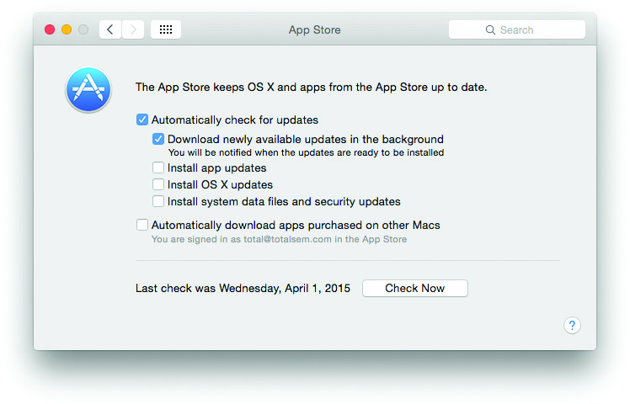
Patch Management in Mac OS X and Linux
Figure 15.4 App Store update options

Slide 12
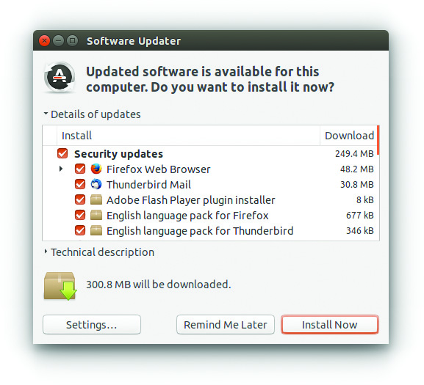
Patch Management in Mac OS X and Linux
Figure 15.5 Software Updater in Ubuntu Linux

Slide 13
Managing Temporary Files in Windows
The Disk Cleanup utility should be run regularly to clean out junk files.
Disk Cleanup tells you how much space it can free up.
You can choose to compress old files.
Deleting Temporary Internet Files frees up space.

Slide 14
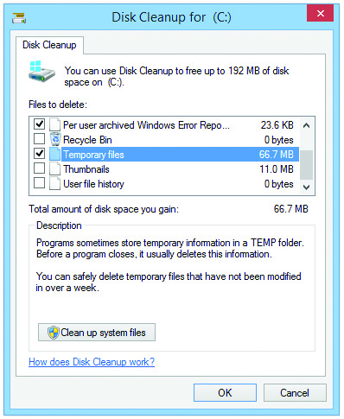
Managing Temporary Files in Windows
Figure 15.6 Disk Cleanup dialog box

Slide 15
Registry Maintenance
The Registry can get clogged with entries that are no longer valid.
This can slow down your system and requires periodic cleaning.
Windows does not have a built-in utility to clean the Registry—you must use a third-party utility.
Several good utilities exist to clean the Registry and system—for example, CCleaner by Piriform, a freeware utility.

Slide 16
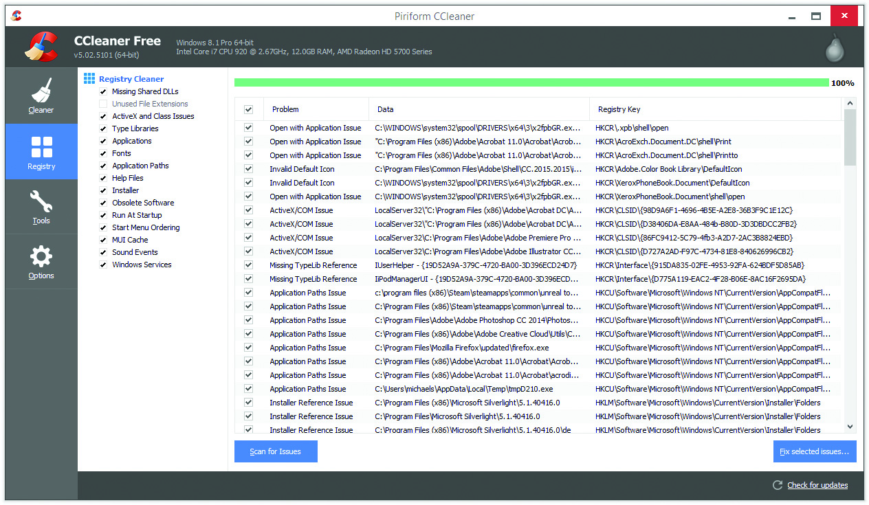
Registry Maintenance
Figure 15.7 CCleaner Registry Cleaner

Slide 17
Disk Maintenance Utilities
Error checking and Disk Defragmentation in Windows
Disk problems can result in errors and system freezes.
Check the disk periodically using the Error checking tool.
You can run Error checking:
By using the chkdsk command from a command line
Through the GUI by opening Computer, Explorer, or File Explorer
By right clicking on the drive, selecting Properties, and then clicking on the Tools tab

Slide 18
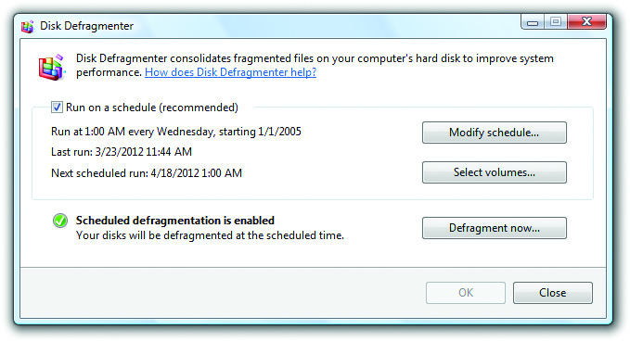
Disk Defragmenter
Run Disk Defragmenter on a regular basis to keep your system from slowing down due to files being scattered in pieces on your hard drive.
Figure 15.8 Vista Disk Defragmenter

Slide 19
Disk Utility in Mac OS X
Mac OS X handles most chores automatically.
Disk Utility is the disk maintenance and utility tool.
Repairs and verifies file structures
Partitions and formats drives

Slide 20
Linux Options
Every distribution offers one or more disk maintenance utilities.
A diagnostic tool is available on the installation DVD.
Boot with installation media in the drive
Ultimate Boot CD is a utility package.
Download from www.ultimatebootcd.com

Slide 21
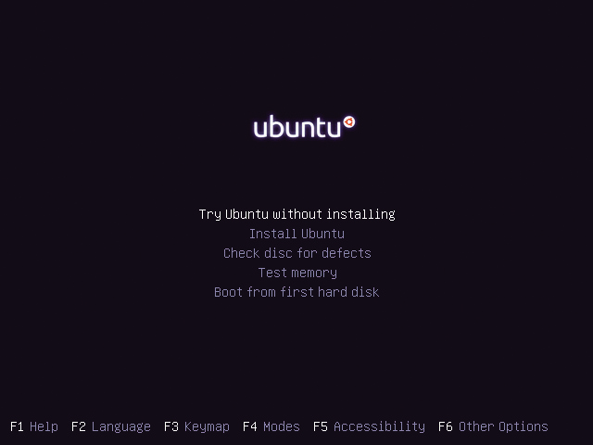
Linux Options
Figure 15.9 Ubuntu installation options, including one for disk diagnosis

Slide 22
Scheduling Maintenance
CompTIA A+ 220-902 exam objectives define two areas for you to consider for scheduled maintenance:
Backups
Disk maintenance

Slide 23
Windows: Task Scheduler
Single administrative tool: Task Scheduler
Choose an executable program and define when you want that program to run.
Task Scheduler divides tasks into triggers, actions, and conditions.
Triggers – actions or schedules that start a program
Actions – steps that define the program to run and how it is to run
Conditions – extra criteria that must be met for the program to run

Slide 24
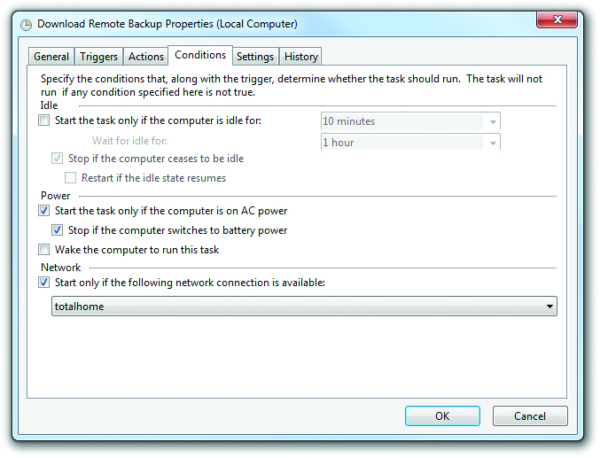
Windows: Task Scheduler
Figure 15.10 Conditions tab in Windows 7 Task Scheduler

Slide 25
Mac OS X and Linux: launchd and cron
Mac OS X and most Linux distributions use one of two scripting tools to run all sorts of tasks automatically in the background.
Apple developed launchd for automation.
Most Linux distros use the older and more universal cron.

Slide 26
Scheduling Backups in Windows
The backup utility varies depending on the version of Windows you are using:
Vista: Backup and Restore Center
Windows 7: Backup and Restore
Windows 8/8.1/10: File History
Windows Vista/7’s Backup and Restore Center/Backup and Restore applet includes a scheduler.

Slide 27
Scheduling Error Checking (Check Disk)
Error checking tool is also called Check disk and chkdsk (the command-line version of the tool).
You can set up Task Scheduler to run it automatically.
Typically only run if you suspect a problem.
Error checking is not run manually in Windows 8/8.1/10.
Periodic tests of the hard drives are run automatically and notify the user if errors are detected.

Slide 28
Controlling Autostarting Software
Small programs that provide support for the OS load when a computer is booted.
Processes and services
Autostarting applications, processes, and services can be managed.
Windows tools: System Configuration and Task Manager
Apple: Users & Groups pane in System Preferences
Linux: Startup Applications folder

Slide 29
System Configuration
Techs use the System Configuration utility (also known by its executable name, msconfig) in Windows Vista/7 to edit and troubleshoot operating system and program startup processes and services.
From Windows 8 on, you can make these changes from Task Manager.
To start the System Configuration utility, go to the Start | Search bar, enter msconfig, and click ok or press enter.

Slide 30
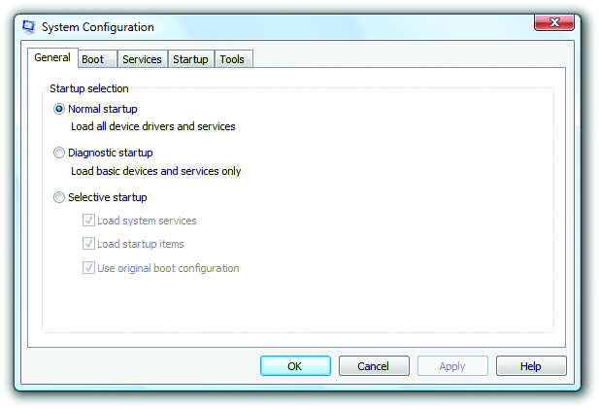
System Configuration
Figure 15.11 Windows Vista System Configuration utility

Slide 31
System Configuration
The System Configuration utility features
General tab – can select the type of startup you would like to use for the next boot
A normal startup with all programs and services launching normally
A diagnostic startup with only basic devices and services
A custom boot
Boot tab – contains advanced boot features.
Services tab – identical to the Services tab in the Task Manager

Slide 32
System Configuration
Startup tab – lets you enable or disable startup programs (programs that load when you launch Windows)
Tools tab – lists many of the tools and utilities available in Windows, including Event Viewer, Performance Monitor, and Command Prompt

Slide 33
System Configuration
The System Configuration utility in Windows XP offers quick access to troubleshoot and edit the boot.ini file.
Windows Vista/7 version no longer has this ability.

Slide 34
System Configuration
Task Manager
Press ctrl-shift-esc in Windows 8/8.1/10.
You can readily see the status of each application.
To enable or disable any application, right click and select one of those options.
Users & Groups in Mac OS X
Users & Groups pane of System Preferences
Select or deselect any application for specific user accounts.

Slide 35
System Configuration
Startup Applications
In Ubuntu Linux, access the Startup Applications preferences by searching for “Startup.”
Deselect the check box next to a program to stop it from loading at boot.

Slide 36
System Information
Windows comes with a built-in utility known as the System Information tool that collects information about hardware resources, components, and the software environment.
Access it from the Start | Search bar
Enter msinfo32.
You can use System Information to gather information about remote computers.
Select View | Remote Computer and then enter the remote computer’s network machine name.

Slide 37
Microsoft Management Console
A complaint about early Windows was the wide dispersal of many utilities needed for administration and troubleshooting.
The Microsoft Management Console (MMC) is a shell program that holds individual utilities called snap-ins.
You can create customized MMCs for your task needs.
Type mmc in the Start | Search bar or the Start screen.

Slide 38
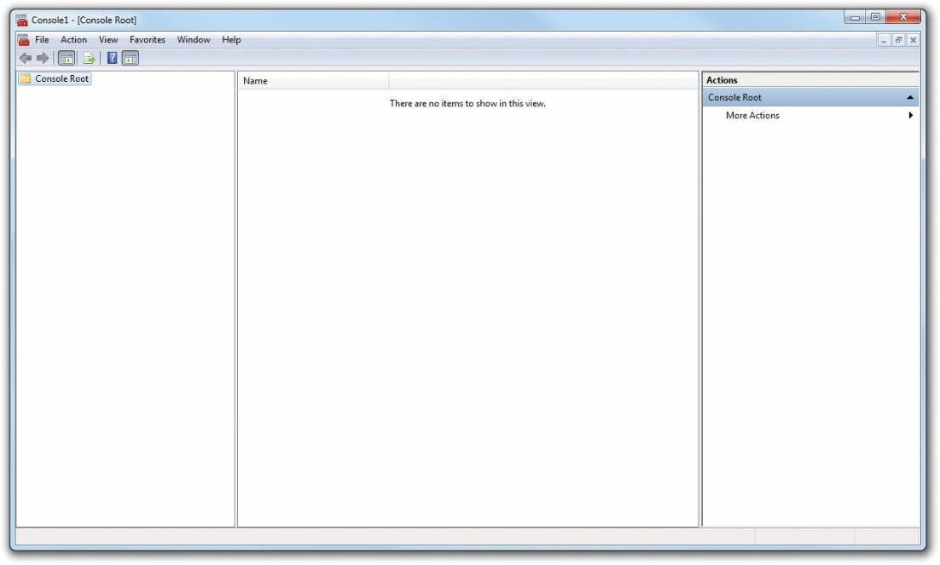
Microsoft Management Console
Figure 15.16 Blank MMC

Slide 39
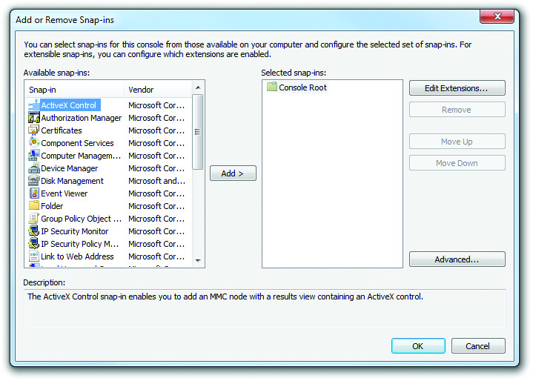
Microsoft Management Console
Figure 15.17 Available snap-ins

Slide 40
Optimizing Operating Systems
Optimization is anything you do that makes Windows better than it was before.
Example: adding a piece of software or hardware to make something run better

Slide 41
Installing and Removing Software
Installing software in Windows
Many installation programs start automatically via Autorun or Autoplay.
To start installation manually, double-click on the disc icon in Explorer or File Explorer.
The UAC may require administrator privileges to install programs.
Accept terms of software license before installation.

Slide 42
Installing and Removing Software
Installing software in Mac OS X
Most common method involves Mac App Store.
Alternatively, download installation programs, often .dmg files, that you drag to the Applications folder.
Installing software in Linux
Commonly download an installation file, double-click, and select install.

Slide 43
Installing and Removing Software
Removing software
Use the program’s own uninstall feature.
If an uninstall program is not available, use the Programs and Features applet to remove the software.
Uninstalling in Mac OS X varies based on how the program was installed.
Use Launchpad technique
Drag the app to the trash
For uninstalling in Linux, use the software manager.

Slide 44
Installing and Removing Software
Adding or removing Windows components/features
Open the Programs and Features applet in the Control Panel.
Click the Turn Windows features on or off option on the Tasks list.
Click Continue if prompted by UAC and you will be presented with the Windows Features dialog box.
Turn a feature on/off by clicking its check box.

Slide 45
Installing/Optimizing a Device
The processes for optimizing hardware in Windows are identical among the versions, even down to the troubleshooting utilities.
Steps for installing a new device are very similar:
Update the drivers.
Verify that the device works properly.
If drivers are buggy, use driver rollback.
Never run beta drivers.

Slide 46
Installing/Optimizing a Device
Updating drivers in Mac OS X
OS will notify you of available system updates that contain driver updates.
For third-party devices, you must manually check the drivers.
Updating drivers in Linux
Most distros will signal any new updates.
Download and install using Software Updater.

Slide 47
Installing/Optimizing a Device
Device Manager
Use Device Manager for optimizing device drivers.
Right-click on a device to display the context menu.
You can update or uninstall the driver, disable the device, scan for hardware changes, or display the Properties dialog box.
The Driver tab has buttons labeled:
Driver Details
Update Driver
Roll Back Driver
Uninstall
Disable

Slide 48
Installing/Optimizing a Device
Adding a New Device
Windows should automatically detect any new device you install in your system.
If Windows does not detect a newly connected device, use the following to get the device recognized and drivers installed:
Use Vista’s Add Hardware Wizard, which you can find in the Add Hardware applet.
Or use the Add a device option in the Devices and Printers applet.

Slide 49
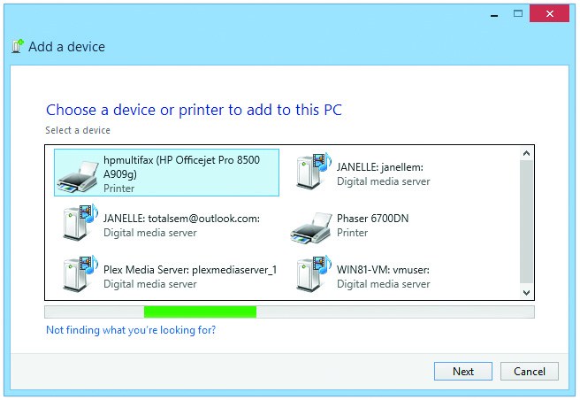
Installing/Optimizing a Device
Figure 15.26 Adding a device in Windows 8.1

Slide 50
Performance Options
Performance options are used to configure CPU, RAM, and virtual memory (page file) settings on all Windows versions.
To access these options:
Right-click Computer or ThisPC.
Select Properties, and then click the Advanced system settings link in the Tasks list.
On the Advanced tab, click the Settings button in the Performance section.

Slide 51
Performance Options
The Performance Options dialog box has three tabs: Visual Effects, Advanced, and Data Execution Prevention.
The Visual Effects tab enables you to adjust visual effects that impact performance, such as animations, thumbnails, and transparencies.

Slide 52
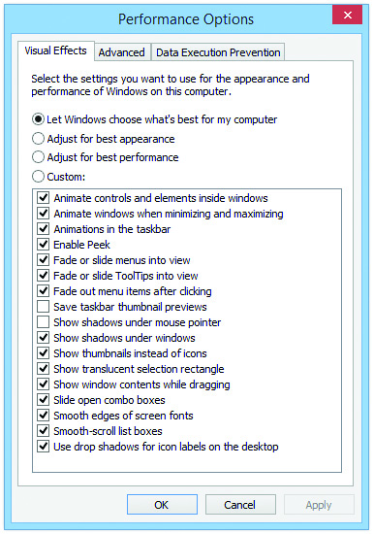
Performance Options
Figure 15.27 Windows 8.1 Performance Options dialog box

Slide 53
Performance Options
The Advanced tab has two sections: Processor scheduling and Virtual memory.
Under the Processor scheduling section, you can choose to adjust for best performance of either Programs or Background services.
The Virtual memory section of this tab enables you to modify the size and location of the page file.

Slide 54
Performance Options
Data Execution Prevention (DEP) works in the background to stop viruses and other malware from taking over programs loaded in system memory.
By default, DEP monitors only critical operating system files in RAM.
The Data Execution Prevention tab enables you to have DEP monitor all running programs—with a significant performance hit.

Slide 55
Preparing for Problems
Techs need to prepare for problems.
Critical system files and data must be backed up.
Tools should be in place for the inevitable glitches.
Every modern operating system has options for backing up data.
Each operating system offers different features

Slide 56
Backing Up Personal Data
Backup and Restore Center for Windows Vista/7
Backup and Restore Center (Vista) and Backup and Restore (Windows 7) are Control Panel applets.
Back up computer option backs up entire computer to a system image.
Back up files (Vista) backs up personal information of all users.

Slide 57
Backing Up Personal Data
Windows 7’s Backup and Restore utility
Click the Set up backup link
Let Windows choose (recommended) – user information and system
Let me choose – pick individual users’ files to backup with option to make a system image

Slide 58
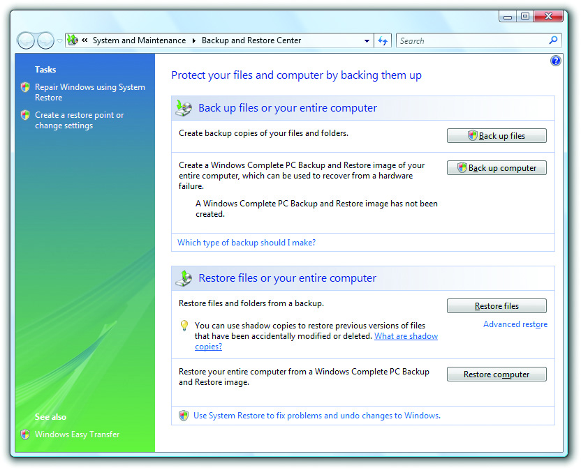
Backing Up Personal Data
Figure 15.29 Backup options in Vista

Slide 59
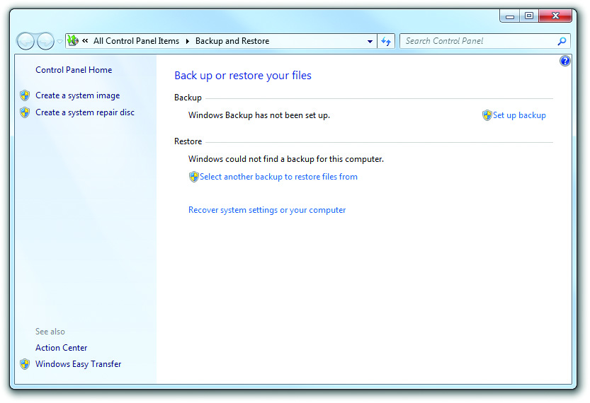
Backing Up Personal Data
Figure 15.32 Windows 7 Backup and Restore

Slide 60
Backing Up Personal Data
File History in Windows 8/8.1/10
The robust File History Control Panel applet was introduced in Windows 8.
Requires a second drive and not enabled by default
Won’t back up personal files unless you add them to the default Libraries or create custom Libraries
File History does not replace full system backups at all.
To back up your system, select the System Image Backup option.

Slide 61
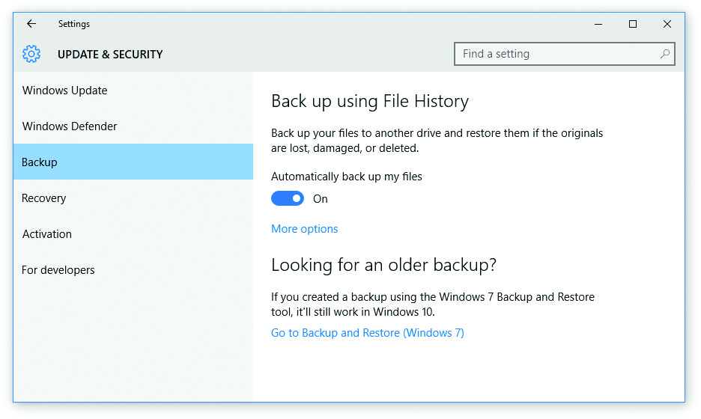
Backing Up Personal Data
Figure 15.37 Windows 10 File History

Slide 62
Backing Up Personal Data
Time Machine in Mac OS X
Time Machine creates full system backups called local snapshots.
Time Machine enables recovery of some or all files in the event of a crash; also enables restoration of deleted files and previous versions of files.
Backups in Linux
Different distros use different tools.
Ubuntu uses Déjà Dup.

Slide 63
System Restore in Windows
The System Restore tool creates a restore point—a snapshot of your computer’s configuration at a specific point in time.
If you later crash or have a corrupted OS, you can restore the system to its previous state.

Slide 64
System Restore in Windows
System Restore makes a number of restore points automatically.
To make your own restore point:
Right-click Computer and select Properties.
Click the System protection link in the Tasks list.
On the System Protection tab, click the Create button to open the dialog box.
Name the restore point appropriately and then click Create.

Slide 65
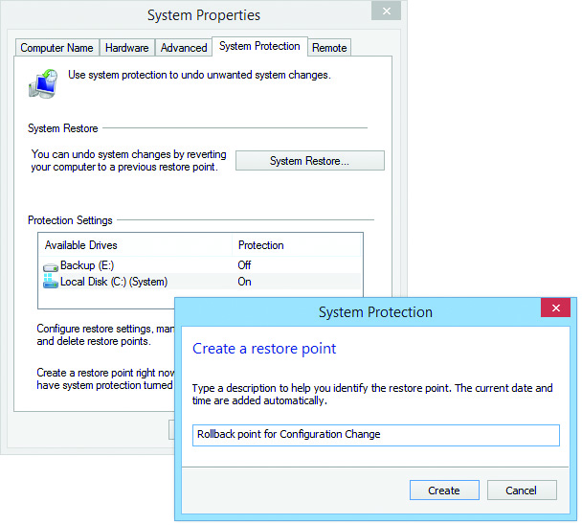
System Restore in Windows
Figure 15.40 Creating a manual restore point in Windows

Slide 66
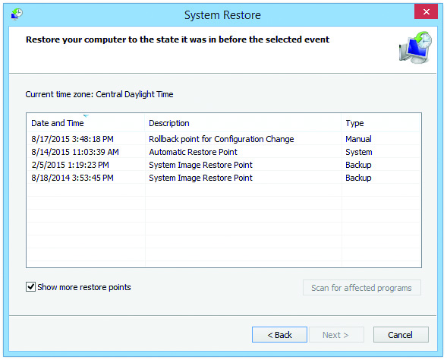
System Restore in Windows
Figure 15.41 Restore points in Windows

Slide 67
System Restore in Windows
During the restore process, only settings and programs are changed—no data is lost.
Your computer includes all programs and settings as of the restore date.
System Restore is turned on by default.
To turn off or change space usage, right click Computer or ThisPC and select Properties.
Click the System protection link in the Tasks list.
On the System protection tab, click the Configure button to change settings.

Slide 68


Slide 69
Summary
Perform operating system maintenance tasks
Optimize operating systems
Prepare for problems

Slide 70


